Slide 1

Sorry Mr(s) Ops, We Hadn’t Forgotten You: Part two of the Hiscox DevOps Journey DevOps Enterprise Summit 2017
Jon Fletcher

Slide 2




Me
Jonathan Fletcher
Interim Group CTO Hiscox
Ex Dev
Ex Ops
http://enterprisedevops.blogspot.com
@FletcherJofanon
jonathan.fletcher@hiscox.com

Slide 3
Who are Hiscox?
International specialist insurer
> $3bn in GWP
~ 2,500 employees
UK
Birmingham
Colchester
Glasgow
Leeds
London
Maidenhead
Manchester
York
Guernsey
St Peter Port
Europe
Amsterdam
Bordeaux
Brussels
Cologne
Dublin
Hamburg
Lisbon
Lyon
Madrid
Munich
Paris
USA
Atlanta
Chicago
Los Angeles
New York City
San Francisco
White Plains
Bermuda
Hamilton
Latin American
gateway
Miami
Asia
Bangkok Hong Kong
Singapore

Slide 4

Last year – DOES ’16 key points
The journey from a large centralised IT function to a federated one
The efficiency gains achieved through Continuous Delivery
We weren’t really doing “DevOps” – CD for applications is only half the battle. Where is Ops?
Starting a move to the Cloud and hoping that a synergy of tooling and processes can help bring us closer towards “DevOps”
Before | After
Team of 8 people involved in a release | Max 2 people involved in a release
~2 deploys a week | ~ 50 deploys a day
3-4 hours deployment time | 20 minutes deployment time
Only 5 environments | 31 environments

Slide 5
A brief history of IT...
 | 1970’s - 1980 | 1990’s | 2000’s - Present
Era | Mainframes | Client/Server | Commodisation and Cloud
Representative tech | Cobol, Db2 | C++, Oracle | Java, MySQL, .net
Cycle time | 1-5 years | 3-12 months | 2-12 weeks
Cost | $1m-$100m | $100k-$10m | $10-$1m
At risk | Whole company | Product line or division | A product feature
Cost of failure | Bankruptcy, sell the company, massive layoffs | Revenue miss, CIO’s job | Negligible
*Adrian Cockcroft: Velocity and volume presentation

Slide 6

The Three Most Important Events In enterprise IT in the last decade
Salesforce.com IPO, 2004
Launch of Amazon Web Services, 2006
Release of Apple iPhone, 2007
Showed that Software as a Service (SaaS) works
As both a technology and a business model
Introduced public cloud platforms
Provided a new technology and a new business model
The first truly successful smartphone
Notes:
David Chappell

Slide 7

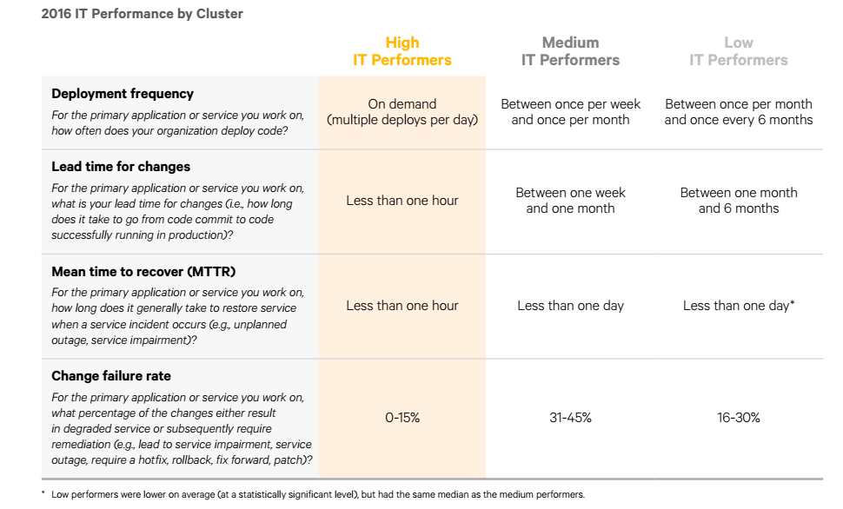
Characteristics of high performing IT teams

Slide 8
A revised history of IT...
We are here (ish)
I think we need the capability to get here
 | 1970’s - 1980 | 1990’s | 2000’s | Today’s high performers
Era | Mainframes | Client/Server | Commodisation | Cloud & mobile first
Representative tech | Cobol, Db2 | C++, Oracle | Java, MySQL, .net | Node, Angular, NoSQL
Cycle time | 1-5 years | 3-12 months | 2-12 weeks | Hours
Cost | $1m-$100m | $100k-$10m | $100k-$1m | $10k-$100k
Delivery methodologies | Heavyweight & waterfall | Heavyweight & waterfall | Lighter weight, incremental, beginnings of Agile | Agile, Lean, DevOps
At risk | Whole company | Product line or division | A product feature | Subset of a feature
Cost of failure | Bankruptcy, sell the company, massive layoffs | Revenue miss, CIO’s job | Project over-budget, slapped wrists | Negligible
*Adapted from Adrian Cockcroft: Velocity and volume presentation

Slide 9
Cloud @ Hiscox
IBM SoftLayer, Google Cloud, Rackspace Cloud were largely ruled out due to position on Gartner Quadrant
This doesn’t rule out multi-Cloud later, we just needed to start somewhere
Generally, I find having 3rd party validation carries a lot of weight with the business
After a series of proof of concepts, we selected Microsoft Azure over Amazon AWS
One key factor was that Hiscox have traditionally been a Microsoft house and we felt they were more geared up to the needs of the Enterprise
So far? Fantastic!

Slide 10
How are we transitioning to Cloud First?
Until we decommission our on-premise infrastructure we are likely to see total costs of running IT increase
Therefore we need to get from one state to another as fast as possible
I’ve always been against moving a problem from one data centre to another – IaaS has its place but its only going to realise a subset of the benefits of a true Cloud-native application
However, pragmatism is now settling in (I’m a corporate sell out)
Where an application has a ROI for being re-architected then do it
Otherwise, lift and shift asap and turn off our data centres. Move then fix.
We started small but we are now at an inflection point – 3 of our biggest systems go live in H2 this year – hundreds of million $$$
However, moving to the Cloud isn’t the answer to all our challenges without investigating significant effort and cost – people, process, technology, culture all need to be addressed

Slide 11
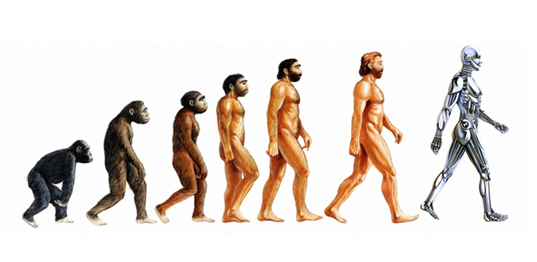
Evolution
Revolution
2011
2014
2020
2008
2017
Beginnings of Agile
Continuous Delivery
Beginnings of Lean
Waterfall
DevOps
Federation
Dev
Beg. of Agile
Beg. end of tickets
ITIL
DevOps
Operations
Infrastructure
Co-located data centres
Cloud first
Data centre in basement
Beginnings of cloud
Notes:
Not comparing employees to Neanderthal
We are on a journey – it takes time in an Enterprise with several hundred applications and employees
I think what we have done to date is great but its incremental. The revolution happens I think around 2020

Slide 12

The IT-less IT team
Purpose?
Focus on high-value tasks that bring competitive advantage to Hiscox
Flatten the expense ratio
How?
Borrow, Buy, Bend, Build
IT are a broker and integrators of technology capabilities rather than creators of them
All sides of the IT organisation are using the same processes, toolsets and cultural ideologies
BizDevOps – no “IT and the business”
2020

Slide 13


Current Infrastructure and Operations Services model
In the current model technical leadership and line management run horizontally and
project delivery is done through waterfall
Citrix
VMware / Server
Storage
Network
Service Desk
AD / Messaging
Unified Comms
DBA
Tech Lead
Infrastructure Specialist
Notes:
Line management horizontal
Line management & tech leadership
Waterfall

Slide 14
New direction – from horizontal to vertical
Lon
Col
York
Man
ATL
Service Desk
Service Management
Security
Platform team
Team is responsible for ALL platform design (on and off premise), owns HLD, strategy and direction of on and off premise infrastructure
Aligned Agile Squads (delivery of all infrastructure to aligned BU’s). Delivers all project infrastructure (both on and off prem), as well as providing BAU and SIP tasks for assigned products. Some of these squads will be focussed on core infrastructure (build, BAU and SIP)
Scrum Master
Inf Specialist

Slide 15
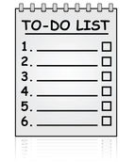
Target Operating Model What will it look like?
Inputs
Business PMs
ITS PM’s
Business Services Manager
Operations
Manager
Inputs
ITSM
Tickets
Tech Debt
Shared Inputs
IA’s
TDA’s
Security
Compliance
CTO
Sprint Backlogs
Colc
Yor
Man
Atl
TDA / IA Function
Lon
Local PO
Scrum
Master
Team
Notes:
Elaboration done by the teams

Slide 16
Technology tribes (Spotify model) Knowledge sharing & best practise
Delivery focus
Vertical
TDA
Technology focus
horizontal
Citrix
Infrastructure specialist
VMware / Server
Storage
Network
AD / Messaging
Unified Comms
DBA

Slide 17


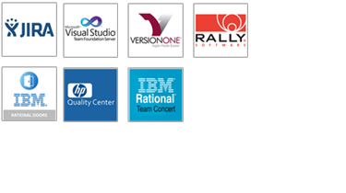

Workload management silos
Dev
Ops
Application Lifecycle Management (ALM)
IT Service Management (ITSM)

Slide 18
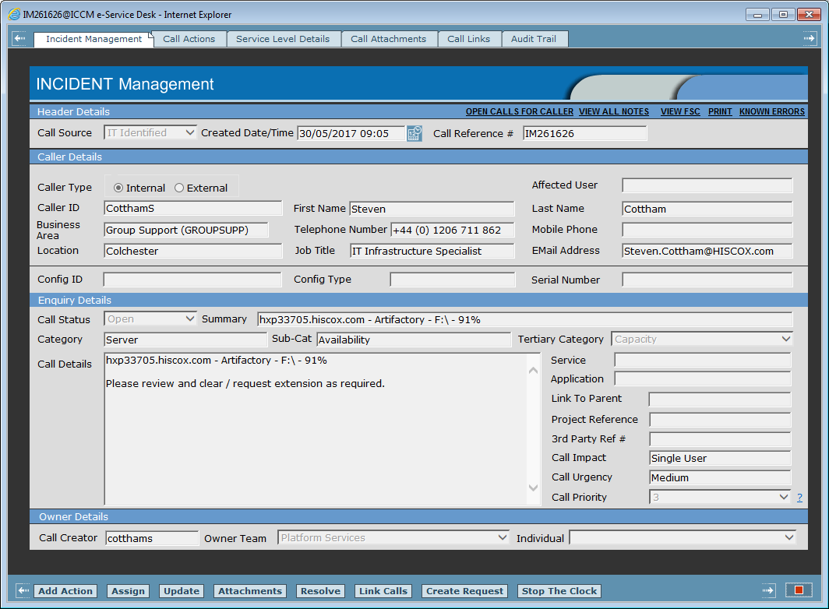
Tickets or stories?
This is just a unit of work:
It has a priority
It’s assigned to someone
It has the details of stuff that needs doing
A bit of a rewrite (particularly to describe value rather than a task) and its easily conceivable this could become a story

Slide 19
So ITSM or ALM?
Actually, there is a place for both ITSM and a place for ALM (I can’t find something that does both)
CMDB? Self-service?
Unrealistic to get end users wanting to raise a support ticket to write user stories on a Scrum/Kanban board
However, its seems counter intuitive to have two systems, for two sets of users when ultimately the aim is to manage and prioritise activities
DevOps is concerned with breaking down silos – not reinforcing them through technology
Pass the ticket perpetuates a “not my problem” attitude
Tickets sit in queues and therefore can increase the time to resolution
Work isn’t always highly visible like it is with Agile processes
We are at RFP stage to find a new ITSM tool to help bring these worlds together

Slide 20

How to argue for Cloud Hiscox DevOps Enterprise Summit 2017

Slide 21
Original Hiscox drivers for Cloud adoption
Increased scalability ✓
Improved elasticity ✓
Lower costs ✓
Increased resilience ✓
Pace of change ✓
Free up the IT team to concentrate on competitive advantage ✓
Improve geographic reach ✓
Planning for the future ✓
Improved security ✓

Slide 22
Cloud is expensive!
Our move to the Cloud is not primarily motivated by cost
That said, we’ve calculated TCO of PaaS 3x cheaper than on-prem, IaaS roughly equivalent (unless you can power it down)
However, it’s very difficult to compare Cloud vs. on-premise infrastructure
Its not just about run costs? How much did it cost to provision? What the cost of waiting for it to be provisioned?
Internally, we’d never build a geo-replicated SQL cluster so how can we compare cost?
Our IT strategy has highlighted an increased pace of change and increased reliability not just cost-control
The move to the Cloud may mean incurring costs in other areas i.e. automation, monitoring, staffing costs etc

Slide 23
Cloud isn’t for Enterprise workloads!
Incident | Date | Outage | Est. days lost | Est internal lost cost
SAN controller locking | 2007 | 12 Hours | 750 | £500k
SAN SCSI reservation issue | 2008 | 8 Hours | 700 | £300k
Network outage | 2011 | 8 Hours | 250 | £200k
SAN incident | 2014 | 16 Hours | 1,400 | £1m
2nd SAN incident | 2014 | 24 hours | 1,300 | £1m
Unknown event | 2018 | 36 hours | 6,000 | £5m

Slide 24
Cloud is about value – not necessarily cost Competitive advantage
Competitive advantage is created by disruption away from the current state through such things as...
Innovation
Cost reduction
Scalability
Speed to market
Deep understanding of the business
Not
Undifferentiated heavy lifting and maintaining the status quo

Slide 25
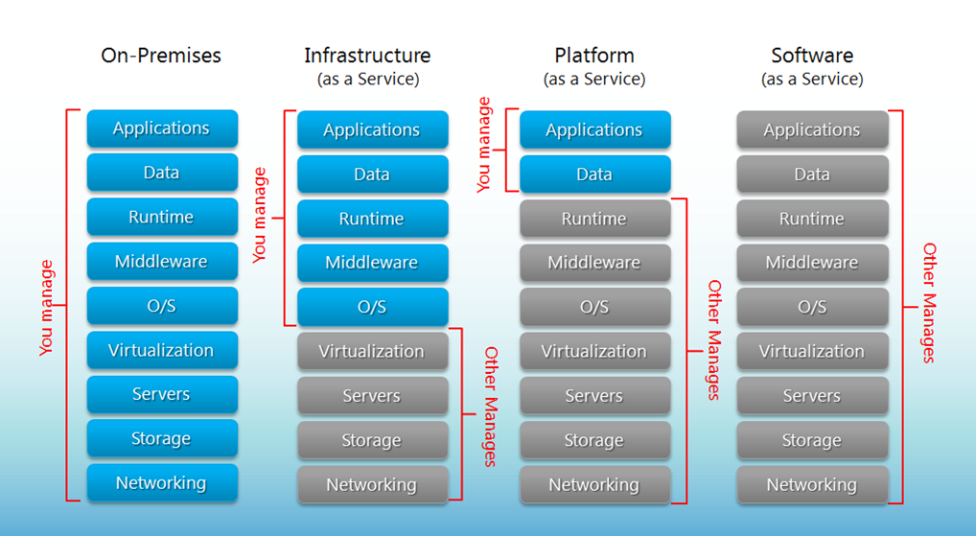
Removing uncompetitive capabilities
What happens to all these techies?

Slide 26

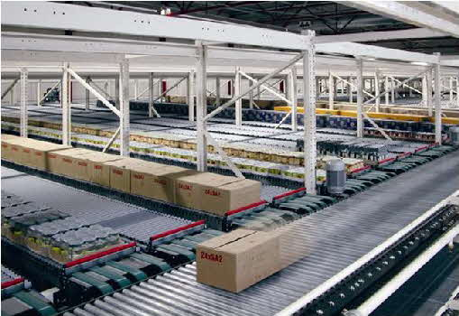
How do we increase our value?
The move to the Cloud is about us freeing up resource to work on high value tasks and increasing our competitive advantage
It doesn’t mean losing people - it may mean changing what they do and how they bring value to the organisation

Slide 27
Geographic reach
Hiscox is expanding globally, both in terms of operations and customers
The “shop door” is always open
In order to provide a timely & responsive service; data needs to be near the end user
Therefore does serving everyone out of London make sense?
Geographic spread and a 24x7 business means maintenance windows are scarce
Cloud services can help with these geographic challenges by situating key services nearer the end user

Slide 28
A platform for the future
Cloud providers are spending billions on new capabilities – some of which aren’t relevant to us now
These might not be relevant now but what about in the future?
We can’t predict the future but we can help plan to respond to it
Cloud opens Hiscox to a world of opportunities that realistically wouldn’t be possible if we were try to build them ourselves

Slide 29

Cloud is unsecure!
Argentina PDPA
Canadian Privacy Laws
CDSA
China GB 18030
China MLPS
China TRUCS
CJIS
Cloud Security Alliance CCM
CS Mark (Gold)
DISA
ENISA IAF
EU Model Clauses
EU-US Privacy Shiled
FACT
FDA
FedRAMP
FERPA
FIPS 140-2
FISC
GxP
HIPAA/HITECH
IRAP
IRS
IS022301
ISO/IEC 27001
IS0/IEC 27017
IS0/IEC 27018
IT Grundschutz Compliance Workbook
ITAR
Japan Number Act
MARS-E
MeitY
MPAA
MTCS
NIST 800-171
PCI-DSS
Section 508 VPAT’s
Shared Assessments
SOC 1
SOC 2
SOC3
UK Gov Cloud
Spain ENS
Game,
Set,
Match
Fletcher

Slide 30
Progress on our Cloud journey Hiscox DevOps Enterprise Summit 2017

Slide 31
Our Cloud journey to date
Cloud Phase 1
Cloud Phase 2
Cloud Phase 3
Cloud Phase 4
Can we get higher levels of availability in the Cloud?
Which Cloud provider is the best fit for Hiscox?
Introduction to Agile for the team
Demonstrate how the concept of Infrastructure as Code (IaC) can be used to automate and standardise deployment of applications & infrastructure
Establish a base capability
Migrate a subset of Hiscox applications to Azure to prove benefits can be realised
Scale our Cloud delivery capabilities
Continue to build core platform
2015 H1
2015 H2
2016
2017

Slide 32
Moving to the Cloud
We believe that candidates for the cloud will come from three sources:
Cloud Benefit
We have undertaken a cloud readiness assessment of our top 15 apps to evaluate how simple and what benefit could be gained by moving them to the could
Opportunistic Refresh
Applications that are due a hardware or OS upgrade
New Apps – Direct to cloud
New apps directly onto the cloud platform

Slide 33
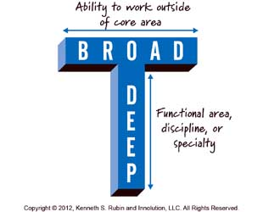

What roles are needed?
The use of Cloud & IaC changes what core skills are needed in our IT dept
Attitude > technology skills
To that end, talking about roles is less relevant – T shaped people
To date, the CTO function led this transformation through a “skunkworks” Cloud team
How do we scale and weaponize this to the rest of the organisation?
We are changing our recruiting strategy
We are looking at creating an “automation academy”
This
Not this
Notes:
Cats into dogs?

Slide 34
So what?
If we don’t transform the organisation then it’s likely our competitors will steal a march on us
If we do transform the organisation then we’ll steal a march on our competitors and create a competitive advantage
We have made a good start with Cloud, Agile and DevOps but this has been largely opportunistic
We are putting in plans to formally digitise our business.
I’m going to need a big cheque & executive sponsorship but I’m passionate the results will be well worth it
This isn’t IT v1.1. This is IT 2.0.

Slide 35
Here’s the help I’m looking for: How do we turn our cats into dogs?

